Slide 1
UNIT 4: INTRODUCTION TO TREE,TREE TRAVERSAL, BINARY SEARCH TREE

Slide 2
Tree data structure
A tree is a non-linear abstract data type with a hierarchy-based structure.
It consists of nodes (where the data is stored) that are connected via links.
The tree data structure stems from a single node called a root node and has subtrees connected to the root.

Slide 3
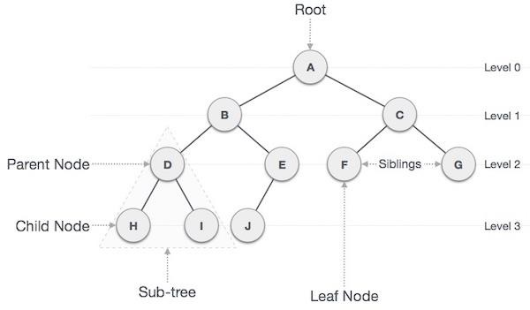
INTRODUCTION TO TREES

Slide 4
Key concepts
Path − Path refers to the sequence of nodes along the edges of a tree.
Root − The node at the top of the tree is called root. There is only one root per tree and one path from the root node to any node.
Parent − Any node except the root node has one edge upward to a node called parent (internal node).
Child − The node below a given node connected by its edge downward is called its child node.
Leaf − The node which does not have any child node is called the leaf node(external node).

Slide 5
Key Concepts
Subtree − Subtree represents the descendants of a node.
Traversing − Traversing means passing through nodes in a specific order.
Levels − Level of a node represents the generation of a node. If the root node is at level 0, then its next child node is at level 1, its grandchild is at level 2, and so on.
Depth – The depth of a node is the number of edges present in path from the root node of a tree to that node.
Height - The height of a node is the maximum number of edges from that node to a leaf node in its subtree.

Slide 6
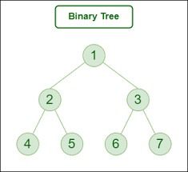
Binary Trees
A binary tree is a hierarchical data structure where each node has at most two children, referred to as the left child and the right child.
It is a fundamental type of tree data structure used for organizing and storing data efficiently.

Slide 7
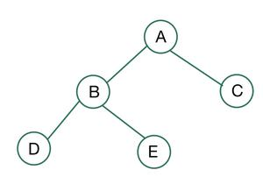
Binary tree types
Based on the number of children, binary trees are divided into three types:
Full Binary Tree: A full binary tree is a binary tree type where every node has either 0 or 2 child nodes.

Slide 8
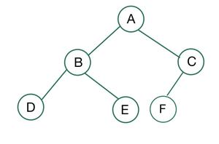
Binary tree types
Complete Binary Tree: A complete binary tree is a special type of binary tree where all the levels of the tree are filled completely except the lowest level nodes which are filled from as left as possible.

Slide 9
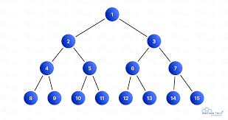
Binary tree types
Perfect Binary Tree: A perfect binary tree is a binary tree type where all the leaf nodes are on the same level and every node except leaf nodes have 2 children.

Slide 10
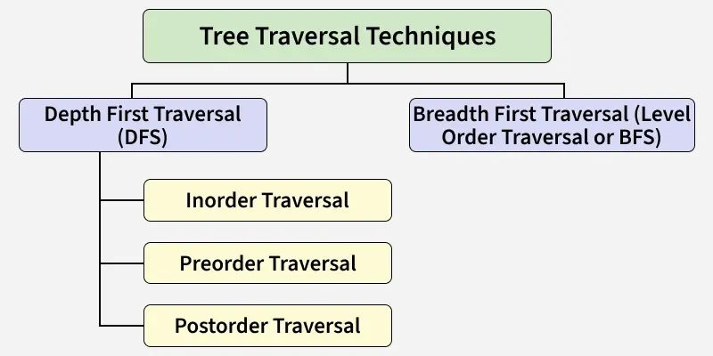

Slide 11
Tree traversal
Tree traversal refers to the process of visiting or accessing each node of a tree exactly once in a specific order.
Because, all nodes are connected via edges (links) we always start from the root (head) node.
Tree traversals are broadly classified into two categories:
Depth First Search (DFS)
Breadth First Search (BFS)

Slide 12
Tree traversal
Depth First Search (DFS)
Explores as far as possible along a branch before exploring the next branch.
Types: In-order, Pre-order, Post-order
Breadth First Search (BFS)
Explores nodes level by level from top to bottom.
Type: Level Order Traversal.

Slide 13
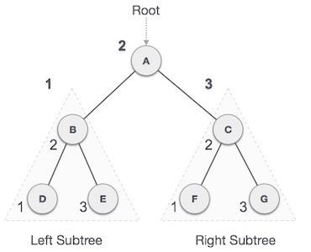
In-order Traversal
In this traversal method, the left subtree is visited first, then the root and later the right sub-tree. We should always remember that every node may represent a subtree itself.
If a binary tree is traversed in-order, the output will produce sorted key values in an ascending order.
We start from A, and following in-order traversal, we move to its left subtree B.B is also traversed in-order. The process goes on until all the nodes are visited. The output of in-order traversal of this tree will be D B E A F C G

Slide 14
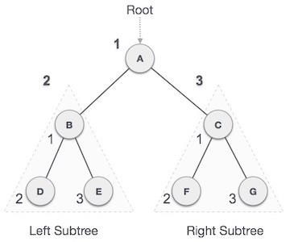
Pre-order Traversal
In this traversal method, the root node is visited first, then the left subtree and finally the right subtree.
We start from A, and following pre-order traversal, we first visit A itself and then move to its left subtree B. B is also traversed pre-order. The process goes on until all the nodes are visited. The output of pre-order traversal of this tree will be −
A → B → D → E → C → F → G

Slide 15
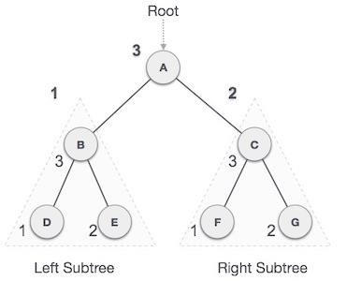
Post-order Traversal
In this traversal method, the root node is visited last, hence the name. First we traverse the left subtree, then the right subtree and finally the root node.
We start from A, and following pre-order traversal, we first visit the left subtree B. B is also traversed post-order. The process goes on until all the nodes are visited. The output of post-order traversal of this tree will be
D → E → B → F → G → C → A

Slide 16
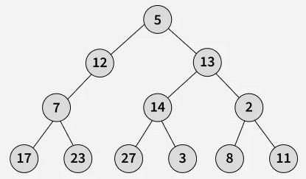
Level-order traversal
Level Order Traversal technique is a method to traverse a Tree such that all nodes present in the same level are traversed completely before traversing the next level.

Slide 17
Level-order traversal
Explanation: Start with the root → [5] Level 1: Visit its children → [12, 13] Level 2: Visit children of 12 and 13 → [7, 14, 2] Level 3: Visit children of 7,14 and 2→ [17, 23, 27, 3, 8, 11]
Output: [[5], [12, 13], [7, 14, 2], [17, 23, 27, 3, 8, 11]]

Slide 18
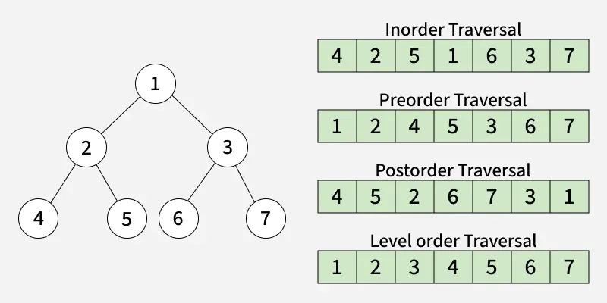
Tree Traversal

Slide 19
Binary Search Tree
A Binary Search Tree (BST) is a data structure that stores elements in a hierarchical, tree-like manner, where each node has at most two children.
The defining property of a BST is its ordering: for any given node, all values in its left subtree are less than the node's value, and all values in its right subtree are greater than the node's value.
This ordered structure allows for efficient search, insertion, and deletion operations.

Slide 20
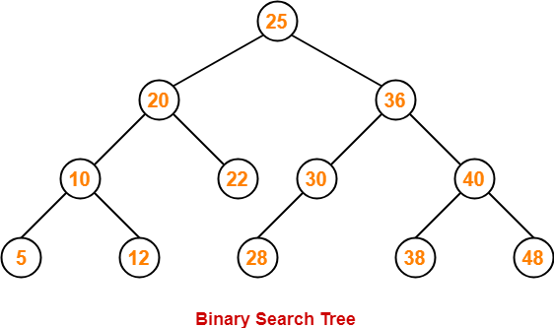
BST Example

Slide 21
Operations in Binary Search Tree
Insertion
Searching
Deletion
Case 1: Node has no children (leaf node): Simply remove the node.
Case 2: Node has one child: Replace the node with its single child.
Case 3: Node has two children: Find the in-order successor (the smallest node in the right subtree) or in-order predecessor (the largest node in the left subtree) of the node to be deleted. Replace the deleted node's value with the successor/predecessor's value, and then delete the successor/predecessor node
Traversal
Minimum/Maximum

